Slide 1
How to Be an Ally Part 1 Equip employees with the knowledge and skills they need to be allies to colleagues.

Slide 2
HOW TO BE AN ALLY
Agenda
Time | Topic
1:00pm-1:10pm | Introduction Learning Objective Ground Rules
1:10pm-1:50pm | Module 1: What does it mean to be an ally?
1:50pm- 2:00pm | Wrap-up
Notes:
Speaker’s Notes:
Today we will be speaking about allyship. This is a high-level overview of the agenda for today.
For conducting the training over two sessions:
We will go over Module 2 on (insert date), when we’ll look at how we can identify the accountabilities and responsibilities of allies and how we’ll practice being an ally in our workplace.

Slide 3
HOW TO BE AN ALLY
Learning
Objective
1. Define allyship and core concepts related to being an ally

Slide 4
Ground Rules
HOW TO BE AN ALLY
Respect each other and avoid judgment
Share only what you are comfortable with and maintain confidentiality
Everyone’s experience is valid
Allow people to finish their thoughts
Use “I” statements

Slide 5
HOW TO BE AN ALLY
What does it mean to be an ally?

Slide 6
Think of a time when someone stood up for you or when you witnessed someone standing up for another person.
How did that make you feel?
How did it have an impact on your life?
What does allyship mean to you?
​
Activity

Slide 7
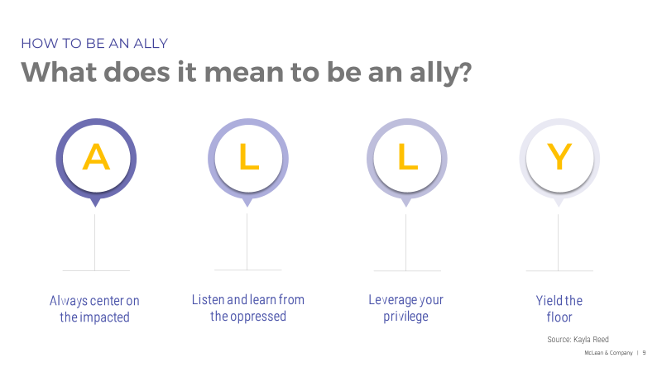

Slide 9
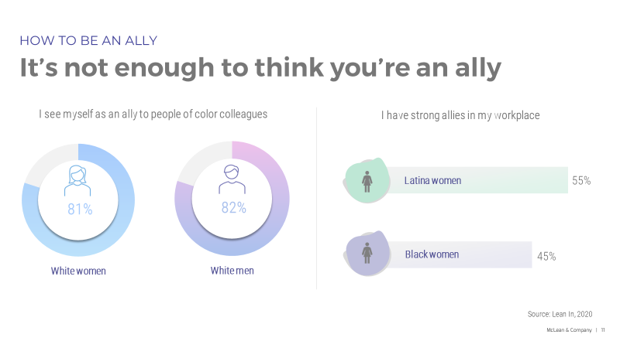

Slide 15
Thank you!!!

Slide 16
HOW TO BE AN ALLY
Allyship accountabilities and responsibilities

Slide 17
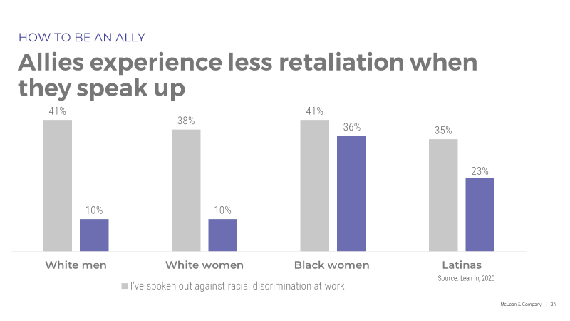

Slide 19
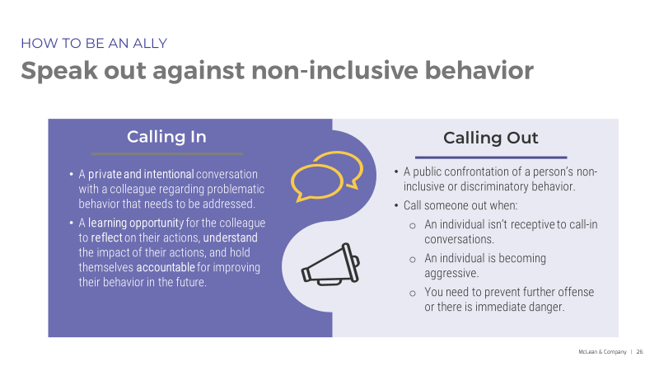

Slide 22
